Slide 1

IMPLEMENTATION OF FILE SYSTEM MANAGEMENT
GOKULRAJ S (192224130)

Slide 2
File System
A file system is a method for organizing, storing, and retrieving data files and folders on a storage device.
It provides a structured approach for managing disk space and enables users to interact with files efficiently.
It provides a logical layer that abstracts the complexities of physical storage media, enabling users to interact with files in a user-friendly manner.
It translates logical file requests from the user or applications into physical operations on the storage media.

Slide 3

Components of File system
                Disk Block
                Index nodes
                Directory Entries
                File system layer

Slide 4
Components of File System
Disk Blocks:
The storage device is segmented into fixed-size blocks that serve as the fundamental units for storing data.
Index nodes:
These metadata structures are akin to a file's digital passport.
They store crucial information about a file, including its size, location on disk blocks (allocation), permissions controlling access, and timestamps for creation and modification.
Directory Entries:
These entries link filenames to their corresponding inodes, providing a hierarchical organization for files and folders.
File System Layer:
This software layer manages the file system structures, handles file operations like creation, deletion, and modification, and interacts with the device driver to access the storage device.

Slide 5
File system Operations
File Deletion:
  The file system marks the associated disk blocks as free, updates the inode, and removes the directory entry.
File Opening:
  The file system locates the inode using the directory entry and prepares the file for reading or writing.
File Closing:
  The file system flushes any modified data to disk and releases resources associated with the open file.
File Reading:
  The file system retrieves data from the allocated disk blocks based on the file pointer.
File Writing:
  The file system updates the data in the allocated disk blocks and adjusts the file size information in the inode.

Slide 6
File System Types
File Allocation Table (FAT):
  A simple file system with a table that tracks the allocation of disk blocks to files.
New Technology File System (NTFS):
  A journaling file system with features like security, large file size support, and data recovery capabilities.
Extensible File System (ext4):
  A Linux file system known for its high performance, journaling, and scalability.

Slide 7
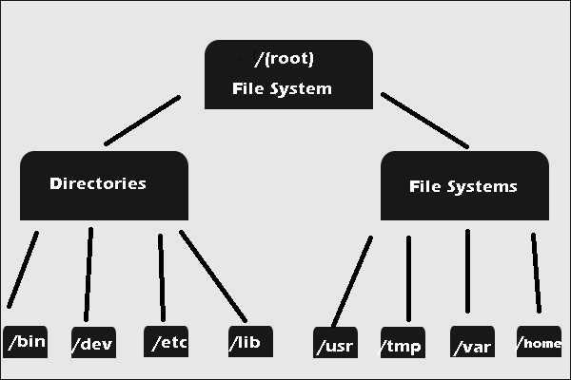

Slide 8
Benefits of using File System in OS
            Data Organization
            Accessibility
            Data Integrity
            Resource Management
            Security
            Convenient Access
            Scalability
            Compatibility

Slide 9
File system security and privacy concern
Access control: Enforce permissions to restrict unauthorized access to files and directories.
Encryption: Safeguards sensitive data from unauthorized access or interception
Authentication: Verify user identities to prevent unauthorized access to file resources.
Auditing and Logging: Track file access and modifications to detect security breaches.
Integrity Checking: Detect and prevent data tampering or corruption, ensuring the integrity and reliability of stored information
Backup and Recovery: Create copies of data and restore it in case of accidental deletion, corruption.
Network Security: Encryption protect data during transmission over networks.

Slide 10
Backup and recovery
Backup:
Creating duplicate copies of data and storing them in a separate location to protect against data loss due to accidental deletion, corruption, or hardware failure.
Backups can be stored on physical media such as tapes or disks, or in cloud storage services for remote accessibility and redundancy.
Recovery:
The process of restoring data from backups in case of data loss or corruption, typically involving retrieving the latest backup and restoring it to the original or alternate location.
Recovery Point Objective (RPO): The maximum tolerable amount of data loss measured in time, indicating the point in time to which data must be recovered after an incident.
Recovery Time Objective (RTO): The maximum acceptable downtime for restoring operations after a data loss event, indicating the time within which systems and services must be restored.
Backup and Recovery Strategies: Implementing backup schedules, retention policies, and testing procedures to ensure backups are up-to-date, accessible, and reliable for recovery purposes.

Slide 11
Conclusion
Effective file system management is crucial for data organization, accessibility, security, and integrity.
Robust architectures, access controls, encryption, and backups are key elements of file system management.
Embracing future trends like hybrid cloud, AI-driven management, and blockchain security is essential for staying competitive.
Prioritizing file system management maximizes data value and minimizes risks of loss, unauthorized access, and compliance issues

Slide 12

Thank You

